Slide 1
CGB1201 – JAVA PROGRAMMING
Department of Artificial Intelligence and Data Science
Academic Year: 2024 – 2025 (Odd Semester)
Register Number : 2303811724322116
Name : TAMILDEEPAA A
Year : II
Semester : III
Section : B
Date : 3/12/2024

Slide 2
Title of the Project
INVENTORY MANAGEMENT SYSTEM

Slide 3
Problem Identification
Overstocking : When businesses over-purchase goods, it leads to high holding costs and potentially obsolete inventory.
Stockouts: Running out of stock at critical times leads to loss of sales, customer dissatisfaction, and a negative impact on the business reputation.
Inefficient Order Processing: Without an automated system, order management becomes slow and error-prone, resulting in delayed deliveries.

Slide 4
Objective
The process of this program is to place and receive orders, including managing purchase orders, sales orders, and returns.
Maintaining the real-time tracking of inventory levels, including incoming and outgoing stock.
Track orders from sales to delivery, ensuring timely dispatch and arrival.

Slide 5
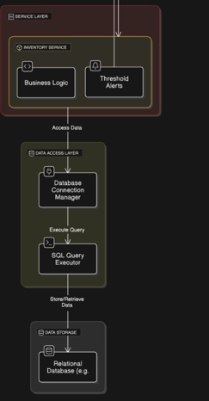
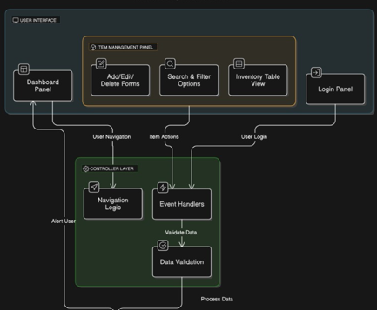
Proposed Architecture

Slide 6
Java Programming - Concepts Used
Object-Oriented Principles: Classes, objects, encapsulation, inheritance, and abstraction.
Event-Driven Programming: Using event listeners and handling user input dynamically.
Exception Handling: Gracefully handling invalid inputs and errors.
Data Structures: Efficiently managing inventory data using a HashMap.
GUI Programming: Building a simple graphical interface using AWT components.

Slide 7
List of Modules
ADD MODULE
UPDATE MODULE
DISPLAY MODULE
REMOVE MODULE

Slide 8
Module Description
ADD MODULE: It allows users to add new products to the inventory. It captures product details such as ID, name, quantity, and price through a dialog box.
UPDATE MODULE: It enables users to update the quantity of an existing product. It prompts the user to enter the product ID and the new quantity through a dialog box.

Slide 9
Module Description (Cont..)
DISPLAY MODULE: It displays all products currently in the inventory. It retrieves the list of products from the displayProducts() method of the Inventory class.
REMOVE MODULE: It provides functionality to remove a product from the inventory. It prompts the user to input the product ID of the item to be removed through a dialog box.

Slide 10
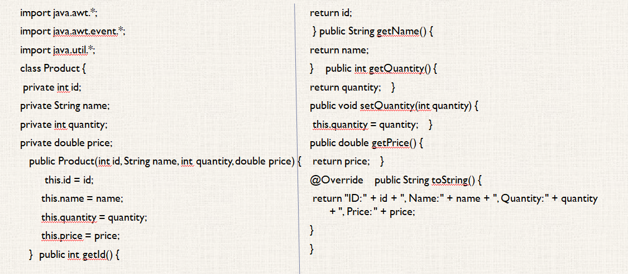
Source Code

Slide 11
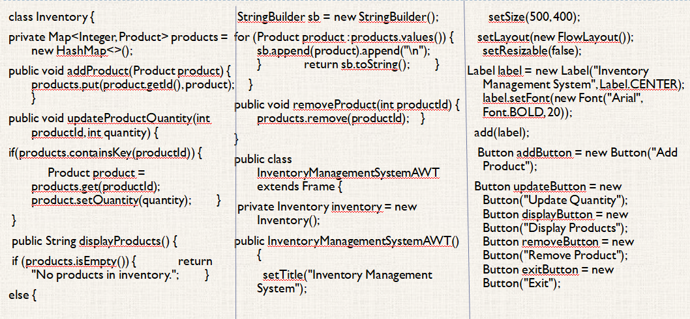
Source Code

Slide 12
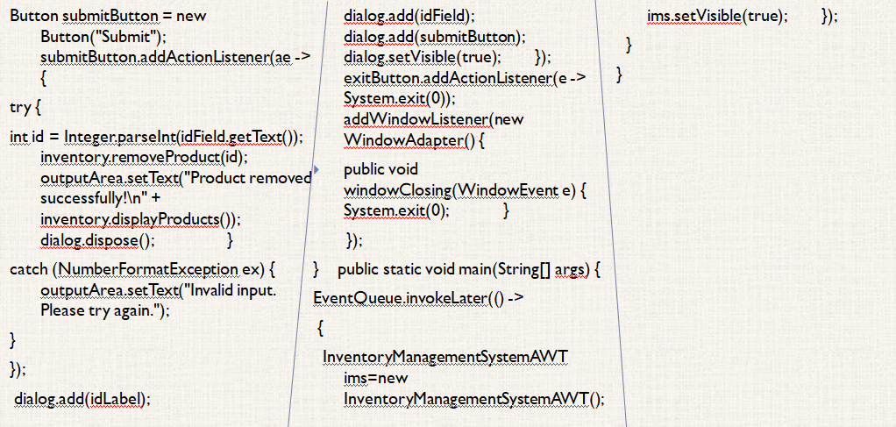
Source Code

Slide 13
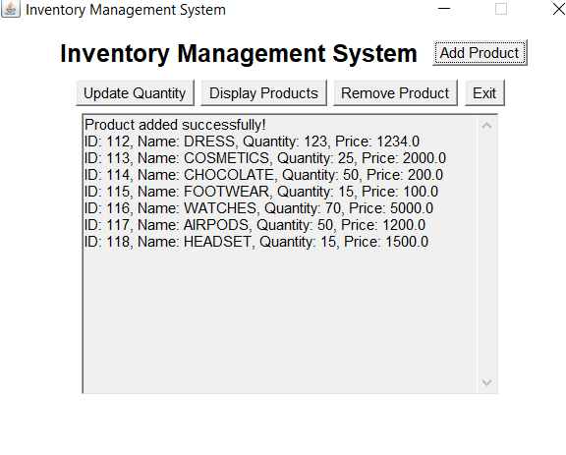
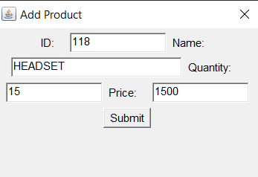
Results

Slide 14
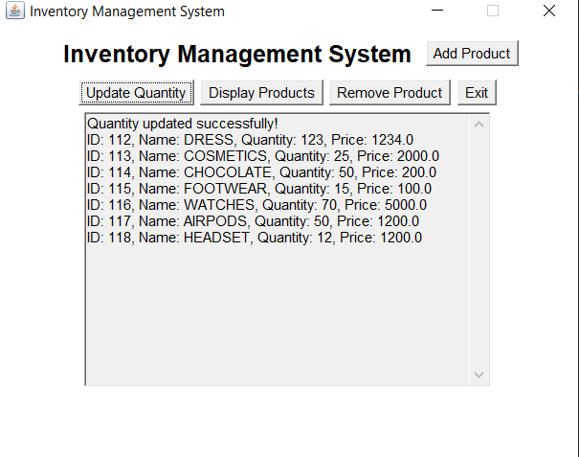
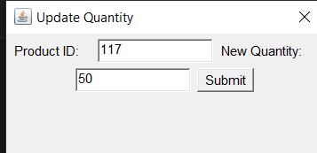
Results

Slide 15
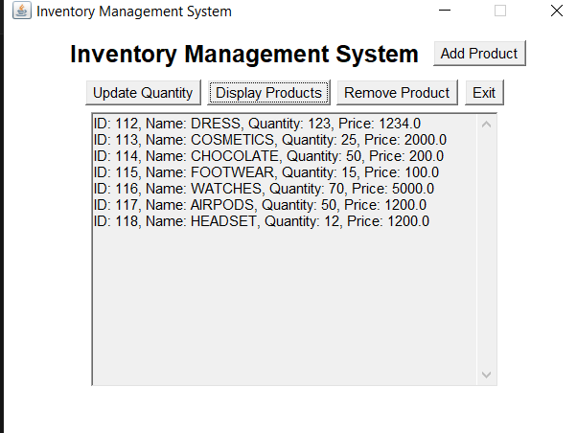
Results

Slide 16
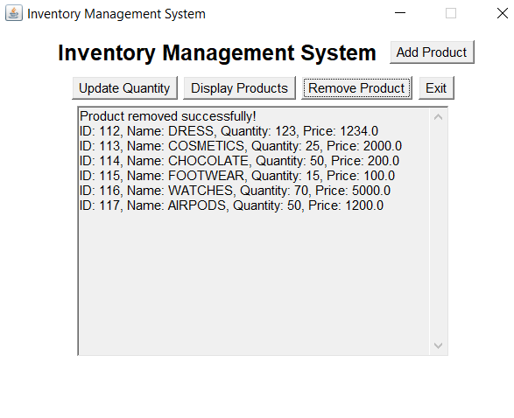
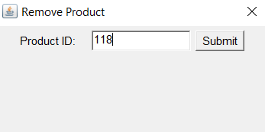
Results

Slide 17
Conclusion
In conclusion, implementing an inventory management system using Abstract Window Toolkit (AWT) in Java provides an efficient and user-friendly solution for managing and monitoring inventory. The system leverages AWT's graphical interface capabilities to create a simple yet effective application for handling essential inventory tasks such as adding, updating, deleting, and viewing product details.

Slide 18
THANK YOU

